Slide 1
Global Issues in the Commercialization of Tissue Engineering
Professor David Williams
Professor of Tissue Engineering
University of Liverpool, UK
Director, UK Centre for Tissue Engineering
Universities of Liverpool and Manchester, UK
dfw@liv.ac.uk

Slide 2
David Williams Relevant Background
Educated as materials scientist
Over 35 years experience in medical technologies
Main research interest in biomaterials and biocompatibility
Establishment of UK Centre for Tissue Engineering
Academic interests in the dialogue between medical device technologies and tissue engineering / regenerative medicine

Slide 3
David Williams Relevant Background
European Commission: SCMPMD
European Commission: SCENIHR
European Commission: Tissue Engineering Regulation
Royal Academy of Engineering: Japan Report
Medical Device Litigation
Editor-in-Chief, Biomaterials
Definitions
Systems Engineering Approach to Tissue Engineering

Slide 4
Global Issues in Tissue Engineering
Aspects to Consider
Clinical perspectives
Disease patterns
Demographic trends
Economic status
Ethics
Innovation in health care
Insurance & reimbursement
Labour costs & manufacturing
Regulation

Slide 5
But first, what do we mean by tissue engineering, regenerative medicine, tissue engineering products and tissue engineering processes
This is not just semantics, but underpins regulations and business models
The main difficulty concerns the differentiation between a tissue engineering process and a product

Slide 6
But first, what do we mean by tissue engineering, regenerative medicine, tissue engineering products and tissue engineering processes
Tissue Engineering
The persuasion of the body to heal itself, through the delivery to the appropriate site of cells, biomolecules and / or supporting structures
The Williams Dictionary of Biomaterials
Liverpool University Press, 1999

Slide 7
Regenerative Medicine
Any therapy that aims to induce the regeneration of tissues or organs following disease or injury, or in the presence of birth or developmental deformities.
Regenerative medicine may be achieved through cell therapy or tissue engineering, either of which may be assisted by concurrent gene transfer or pharmaceutical intervention, or by gene therapy alone.

Slide 8
But first, what do we mean by tissue engineering, regenerative medicine, tissue engineering products and tissue engineering processes
Tissue Engineering Product
Any product , involving cells, biomolecules and / or supporting structures, that is used in an ex vivo or in vivo process for the purpose of the regeneration of tissue for therapeutic purposes
Tissue Engineering Process
Any process that is designed to take cells, and manipulate them, either ex vivo or in vivo, in order to generate new tissue for therapeutic purposes
DFW Suggestions
To be discussed at ESB Consensus Conference, Sorrento, Italy
September 2005, dfw@liv.ac.uk

Slide 9
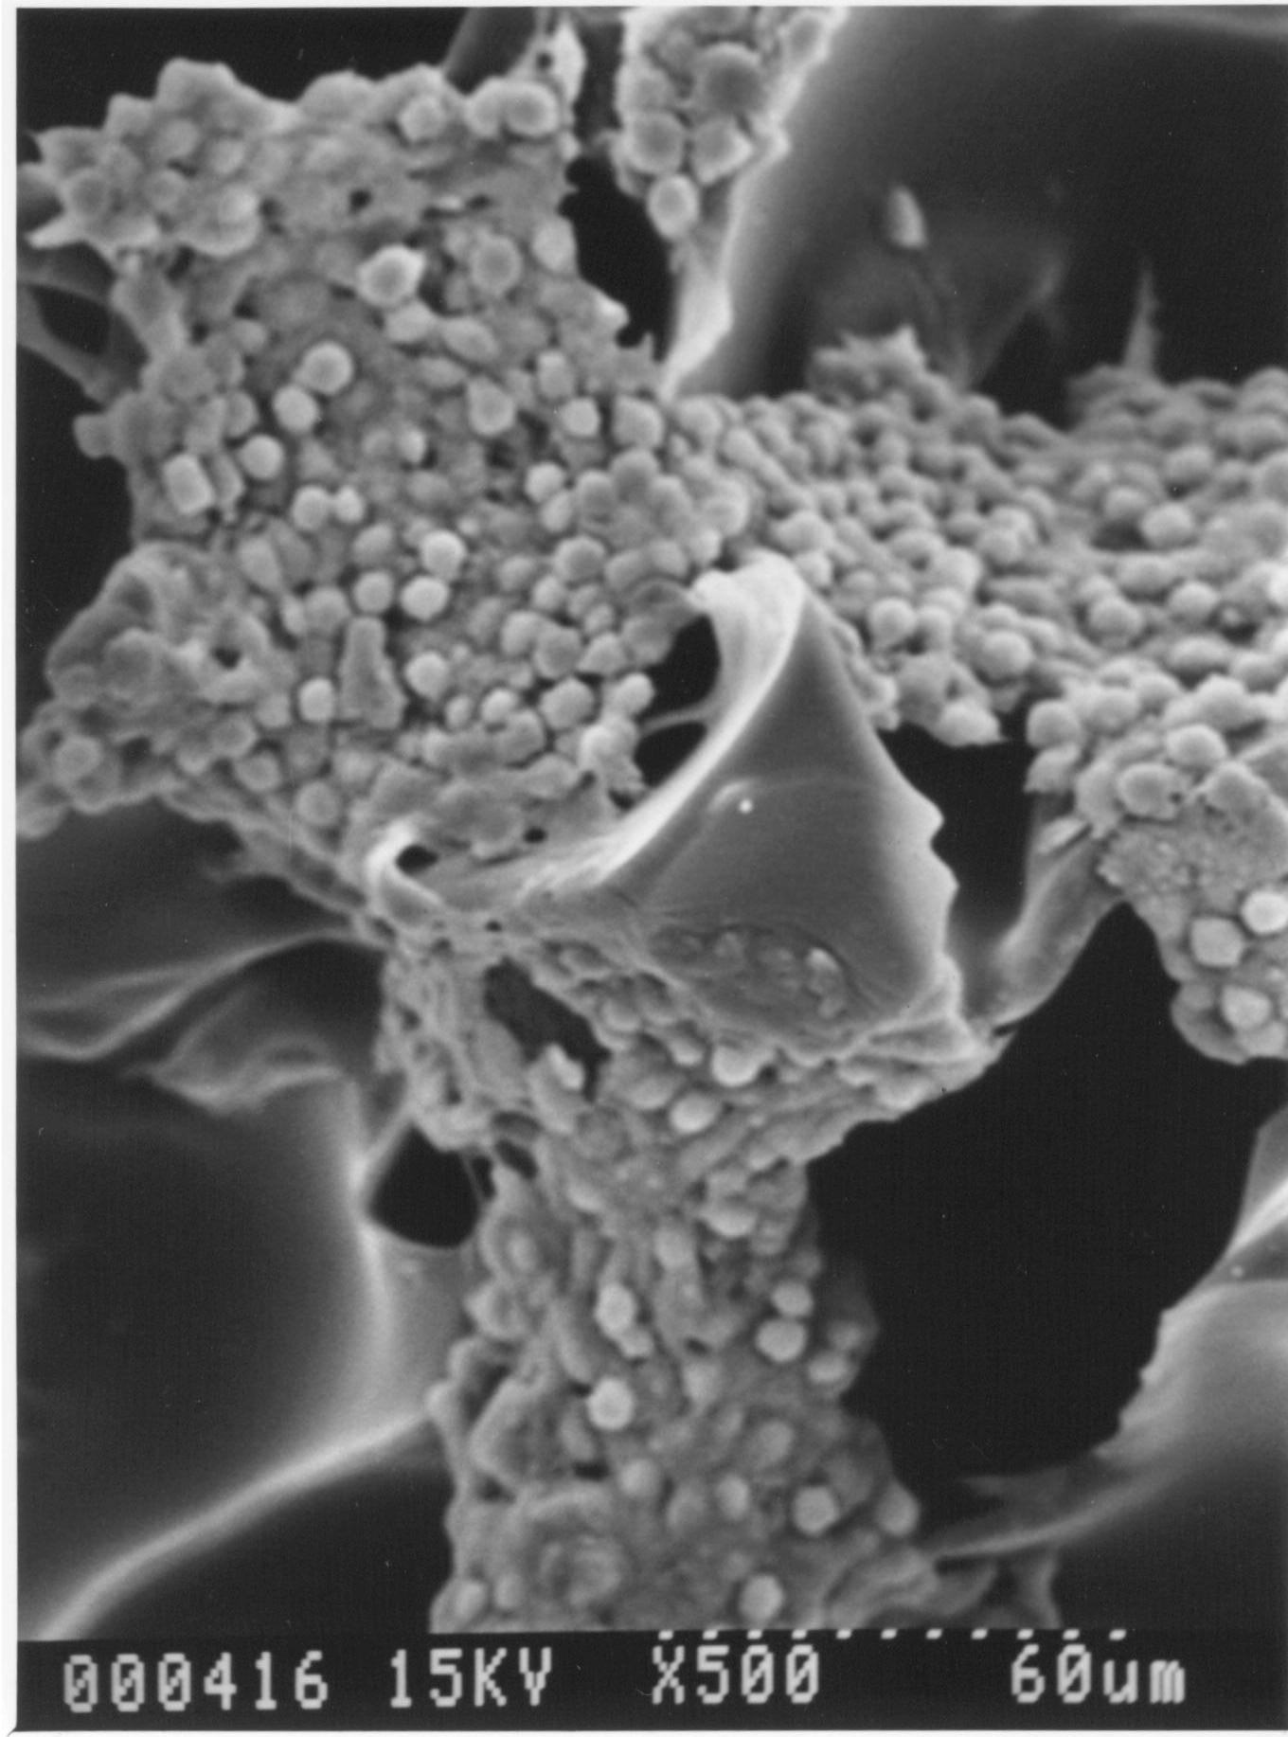

Slide 10
Central Tissue Engineering Paradigm
Cell sourcing
Cell manipulation
Cell signalling
Tissue expression / bioreactor
Implantation of tissue construct
Full incorporation into host

Slide 11
Cell Sources
Autologous
Differentiated phenotype specific to tissue
Stem cells
Frozen cord blood
Allogeneic
Stem cells – embryonic stem cells
Cell bank
Commercial cell line
Xenogeneic
Modified xenotransplant
Feeder cells in commercial products

Slide 12
Scaffolds and Matrices
Synthetic degradable polymers
Natural biopolymers (proteins, polysaccharides)
Bioactive ceramics
Degradable / non degradable hybrids
-
Heterogeneity / anisotropy
Surface active / molecular release
Manufacturing technologies

Slide 13
The Williams Definition of Biocompatibility
‘The ability of a material to perform with an appropriate host response in a specific application’
The Williams Dictionary of Biomaterials
Liverpool University Press, 1999

Slide 14
‘The ability of a material to perform with an appropriate host response in a specific application’
The scientific basis of biocompatibility involves the
identification of the causal relationships
between materials and host tissue such that
materials can be designed to elicit the
most appropriate response
This implies that it is possible to determine
unequivocally the way in which material parameter X
influences host response Y
and that knowing this, we can modify X in order to modulate Y

Slide 15
Material Variables
Bulk material composition, microstructure, morphology,
Crystallinity and crystallography,
Elastic constants, compliance,
Surface chemical composition, chemical gradient, molecular mobility,
Surface topography and porosity
Water content, hydrophobic – hydrophilic balance, surface energy
Corrosion parameters, ion release profile, metal ion toxicity
Polymer degradation profile, degradation product toxicity
Leachables, catalysts, additives, contaminants
Ceramic dissolution profile
Wear debris release profile, particle size
Sterility and endotoxins

Slide 16
Host Response Characteristics
Protein adsorption and desorption characteristics
Complement activation
Platelet adhesion, activation and aggregation
Activation of intrinsic clotting cascade
Neutrophil activation
Fibroblast behaviour and fibrosis
Microvascular changes
Macrophage activation, foreign body giant cell production
Osteoblast / osteoclast responses
Endothelial proliferation
Antibody production, lymphocyte behaviour
Acute hypersensitivity / anaphylaxis
Delayed hypersensitivity
Genotoxicity, reproductive toxicity
Tumour formation

Slide 17
Biocompatibility; Long-term Implantable Devices
The biocompatibility of a long term
implantable medical device refers to the
ability of the device to perform its intended
function, with the desired degree of
incorporation in the host, without eliciting
any undesirable local or systemic effects
in that host

Slide 18
Tissue Engineering Scaffold
The biocompatibility of a scaffold or matrix for a tissue engineering product refers to the ability to perform as a substrate that will support the appropriate cellular activity, including the facilitation of molecular and mechanical signalling systems, in order to optimise tissue regeneration, without eliciting any undesirable effects in those cells, or inducing any undesirable local or systemic responses in the eventual host.

Slide 19
Some Scientific Issues in Tissue Engineering
Better selection and testing of scaffolds and matrices
Autologous cell expansion, maintenance of phenotype and optimisation of efficiency
Control of differentiation of stem cells in the abnormal environment of bioreactors
Control of tissue regeneration in co-cultured heterogeneous anisotropic systems
Optimisation of mechanotransduction

Slide 20
Some Scientific Issues in Tissue Engineering
Development of effective non-viral vectors for gene transfection
Immunomodulation with allogeneic cell derived products
Optimisation of vascularisation and angiogenesis
Functionality of regenerated tissue
Control of inflammation during incorporation into the host

Slide 21
Disease patterns
Diabetes
Cardiovascular disease / heart failure
Neurodegenerative diseases
Joint diseases
Malaria
HIV / AIDS
Dental and oral
Blindness and deafness
Zoonoses (Avian flu, SARS?)

Slide 22
Disease patterns; All cancers, male, 1999
Deaths
Crude rate, per 100,000
Age standardised
Kuwait
247
19.3
60.4
Mauritius
381
67.0
86.3
Azerbajan
2,933
74.8
110.1
Armenia
2,228
120.7
121.7
UK –England
78,810
269.0
152.0
Netherlands
20,987
268.4
173.1
UK-Scotland
7,474
300.7
177.7
Slovakia
7,113
271.1
227.4
Croatia
6,899
315.3
247.7

Slide 23
Demographic trends
USA
UK
Lithuania
India
China
Pop.Growth Rate (%)
1.1
0.3
-0.1
1.8
0.9
% > 60 yr
16.2
20.7
18.8
7.7
10.0
Fertility
2.0
1.6
1.3
3.1
1.8
Life Expect
77.0
77.5
72.9
60.8
71.2
Child mortality
8
7
10
94
37
Adult mortality
144 m
83 f
109 m
69 f
270 m
96 f
291 m
222 f
157 m
106 f
Healthy life expect at 60
14.9 m
16.6 f
15.0 m
16.9 f
11.0 m
14.8 f
9.7 m
10.2 f
12.7 m
14.2 f

Slide 24
Disease patterns
Elimination of many infectious diseases of the west
Failure to eliminate tropical infectious diseases
Rise in non-communicable degenerative diseases
Rise in new epidemics
Changing patterns of trauma, e.g. war and sports related

Slide 25
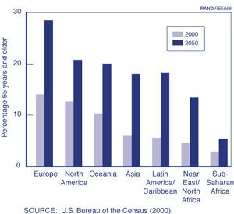

Slide 26
Medical Innovation in an Ageing Society Zweifel, University of Zurich
Insurers and policymakers are sceptical when costly medical innovation is applied to elderly patients. Beyond retirement age, these patients do not contribute any more to the financing of healthcare. In addition it is perceived that the cost of medical care increases with age, seemingly implying that there will be a cost explosion due to population ageing.
However, health economics research consistently shows that the probability of initiating a treatment episode does not increase with age.
Medical expenditure increases sharply with closeness to death regardless of age

Slide 27
Economic status
Factors
GDP – based metrics
Trends
Exchange rates
Political stability
Correlation between economics and health

Slide 28
Economic status
USA
UK
Lithuania
India
China
Per Capita GDP
Int $
34,637
24,462
6,941
1,461
3,852
Health Expend
% GDP
13.0
7.3
6.0
4.9
5.3
Health Expend per Capita, US$
4,499
1,747
185
23
45

Slide 29
Insurance & reimbursement; sources of health care funding
USA
UK
Lithuania
India
China
Gov %
44.3
81.0
72.4
17.8
36.6
Private %
55.7
11.2
27.6
82.2
63.4

Slide 30
Insurance & reimbursement; pervasive influence of government policy on medical treatment
Financial Times; Thursday February 26th 2004
NICE recommends that 3 cycles of in vitro treatment be offered to infertile couples,
The Health Secretary has decided that this is right in principle, but because of financial constraints, only 1 will be offered – thereafter it is not a matter of tax payer interest
A single cycle has a very limited chance of being successful
The policy is economic madness and a waste of money

Slide 31
Hourly Mfg Labour Costs, 1998
US 100
Germany 146.6
Switzerland 131.4
France 98.5
UK 88.5
Australia 80.4
Ireland 71.8
Korea / Singapore 41.9
Japan 27.1
Mexico 9.9
Sri Lanka 2.5

Slide 32
China; Annual Wages,2002
City
RMB
US $
Guangzhou
22,772
2,750
Shanghai
21, 781
2,630
Beijing
19,156
2,313
Tianjin
14,308
1,728
Chongqing
9,523
1,150

Slide 33
Mission to Japan April 2003 Commercialisation of Tissue Engineering
Massive investment by Japanese government in the technology of regenerative medicine
Considerable uncertainty over regulatory pathways
Early clinical innovation under medical licences
No identified pathway for reimbursement
Big pharma standing back
SMEs and investors nervous
Early start-ups already withdrawing
Very high quality science, especially stem cell biology
And especially ESC

Slide 34
Ethical Issues
Autologous cells for tissue regeneration appears to provide an ethics-free zone
BUT CONSIDER
Embryonic stem cells
Gene transfer
The ownership of allogeneic cells and tissues, provided anonymously (donor)
Xenogeneic components ( including feeder cells)
Clinical use without the possibility of predictive pre-clinical tests
Hospitals becoming manufacturers
High risk products used without the possibility of functional testing

Slide 35
Risk management

Slide 36
Risk Management in the Use of Animal Tissues in Medical Devices
NEW SCIENTIST 1987
Brain disease drives cows wild (1987)Vets at the Ministry of Agriculture have identified a new disease in cows that is causing dairy farmers some consternation. The fatal disease, which they have called bovine spongiform encephalopathy, causes degeneration of the brain. Afflicted cows eventually become uncoordinated and difficult to handle. The first case was reported in 1985. Now there are 92 suspected cases in 53 herds, mostly in the South of England. So far 21 cases in 18 herds have been confirmed. All are Friesian/Holstein dairy animals.

Slide 37
Risk Management in the Use of Animal Tissues in Medical Devices
CJD creeps up
Deaths from the human form of mad cow disease in Britain have been rising by a third on average each year since 1995, when the first three deaths from variant Creutzfeldt-Jakob disease occurred. "Such an increase is clearly a matter of concern, although...the absolute number of cases is low," say epidemiologists in The Lancet (vol 356, p 481). By 4 August, the UK CJD Surveillance Unit in Edinburgh had identified 79 cases. But the rate is increasing, with 15 deaths already this year compared with 18 for the whole of 1998. "Until it's known whether this increasing trend is maintained over time, it's difficult to predict future numbers of cases," says Hester Ward, one of the paper's authors.
From New Scientist 12 August 2000.

Slide 38
Risk Management in the Use of Animal Tissues in Medical Devices
Predicted deaths from vCJD slashed
The worst case scenario for the deaths caused by vCJD, the human form of mad cow disease, has been revised downwards from 50,000 to 7000 by a new analysis. In 1997, the UK research group predicted that up to 10 million people could die from the devastating disease. In 2002, the figure dropped to 50,000, based on data up to 2000. Now researchers at Imperial College, London say the likely upper limit of deaths has fallen to 7000.Azra Ghani and colleagues used epidemiological data to model vCJD cases and deaths. Their best estimate now is that 80 more deaths will occur by 2080 - 122 have already died in the UK. However, there is still a lot of uncertainty, says Ghani.

Slide 39
Risk Management in the Use of Animal Tissues in Medical Devices
Canada finds case of 'mad cow disease‘
Canada has announced its first case of "mad cow disease" for a decade, prompting an immediate ban by the US on Canadian beef.But Canadian government officials and cattle farmers are insisting the meat supply is safe, despite the revelation of the case of bovine spongiform encephalopathy (BSE) on Tuesday in a slaughtered cow. The herd of 150 cattle in Alberta, from which the infected cow came, has now been quarantined and will be destroyed and tested for the deadly disease. "We remain confident in our beef and cattle industry," said Shirley McClellan, Minister of Agriculture, Food and Rural Development for Alberta - home to nearly half of Canada's cattle.
New Scientist, May 2003

Slide 40
Risk Management in the Use of Animal Tissues in Medical Devices
US beef producers resist banning of crippled cattle
The US meat industry is resisting the banning of crippled cattle from human food, despite the discovery of the first case of BSE in an American cow. The infected cow was a crippled or a "downer" cow, injured by the birth of a large calf. The cow confirmed positive for BSE on 25 December, after it was slaughtered for food in Washington state earlier in the same month. Meat from the cow was recalled and its herd and offspring were quarantined. The discovery confirms the longstanding warnings of European veterinary experts that BSE could be present in the US. But stringent controls, including banning crippled cattle from human food, have been resisted.
New Scientist, December 2003

Slide 41
Risk Management in the Use of Animal Tissues in Medical Devices
Species
Geographical Source
Veterinary Control / Closed Herds
Infectivity of Tissues
Nature of Device
Anatomical Nature of Device

Slide 42
Regulation
USA, EU, Japan, Australia, ROW
Global Harmonisation
Medical device reclassification
Biologics and the drug-device interface
Tissue Engineering Products & Processes

Slide 43
The Tissue Engineering Regulatory Environment
The regulatory pathway for medical devices is mainly straightforward, albeit different in different parts of the world
– FDA (PMA, 510k etc), EU (CE mark) etc.
The regulatory pathway for pharmaceuticals is also quite straightforward, involving well established phases of clinical trials,
Boundary between drugs and devices becoming a little blurred,
Introduction of more complex biological products leads to difficulties – FDA biologics route, not available in EU,
Organ transplantation not regulated – not a commercial activity,
Tissue banks not always regulated, but becoming an important issue,
Nowhere is there a clear consistent route to regulatory approval for tissue engineering products and processes – not easy to define what is the product and who is the manufacturer.

Slide 44
The Health Care Regulatory Environment in Europe
Pharmaceuticals regulated centrally through European Directive dating back to the 1960s with many revisions. Procedures undertaken by The European Medicines Evaluation Agency, in London.
Medical Devices regulated through a series of three Medical Device Directives in the 1990s, approval being provided by Notifies Bodies, which are profit-making private organisations located across Europe, through the CE marking process. Oversight of the process is provided by Member States through their Competent Authorities.
The distinction between drugs and devices based on the interpretation of the principal intended function of the product. There are no provisions for combination products or biologics

Slide 45
Medical Technology Innovation
Decisions on innovation have to be science driven and not marketing led
Much greater use has to be made of device registries in order to set benchmarks and identify incipient problems with innovation
Industry has to accept the trend of a requirement for more transparency over clinical outcomes and expert analysis /opinion over the benefits and risks of new medical technology concepts
Industry should take the lead in training health care professionals in the use of new technologies
Regulators, governments and health insurers should recognise the difficulties of establishing effective business models with radically new heath care technologies

Slide 46
Medical Technology Innovation
Benefits of Innovative Technologies
Should be assessed on basis of performance of existing technologies
and
The availability of satisfactory alternative therapies
Risks Associated with Innovative Technologies
Should be assessed on the basis of the degree of innovation-
Incremental change or New concept?

Slide 47
EU Reclassification Policy
For the first time, the mechanism provided by the MDD for reclassification of medical devices is being tested. While breast implants have been reclassified as a Class III product, that was achieved under the safeguard clause. Now there is a request from the UK and France to reclassify total hip joint replacements. The proposed reclassification would move total joint replacements from Class IIb to Class III. Also proposed is to place all central nervous system (CNS) devices in Class III.

Slide 48
Reclassification of joint prostheses
Issues
Would reclassification to III from IIB make devices any safer
Would the provision of the need for greater clinical evidence before CE marking improve or damage the availability of joint replacements to patients
Could the use and co-ordination of registries facilitate the early detection of problems
How can the medical device industry and regulators work better to oversee the introduction of radically new technologies to critical devices

Slide 49
Medical device reclassification
Least Burdensome : FDA
The two sections of the Food, Drug, and Cosmetic Act (the act) commonly referred to as the “least burdensome provisions” were enacted by Congress in 1997 to ensure the timely availability of safe and effective new products that will benefit the public and ensure that our Nation continues to lead the world in new product innovation and development. During the last few years, CDRH has been working with its stakeholders to develop an interpretation of the least burdensome provisions. In the May 3, 2001, Federal Register, the draft guidance document entitled, “The Least Burdensome Provision of the FDA Modernization Act of 1997: Concept and Principles” was released for comment. The final document was released on the internet on September 30, 2002 and in the October 4, 2002 Federal Register (67 FR62252). The guidance may be found on the Center’s website at www.fda.gov/cdrh/ode/guidance/1332.html.

Slide 50
Least Burdensome : FDA
We are defining the term “least burdensome” as a successful means of addressing a premarket issue that involves the most appropriate investment of time, effort, and resources on the part of industry and FDA. This concept applies to all devices and device components of combination products regulated by FDA under the device provisions (including in vitro diagnostics (IVDs)). When conscientiously applied, we believe the least burdensome concept will help to expedite the availability of new device technologies without compromising scientific integrity in the decision-making process or FDA’s ability to protect the public health.

Slide 51
Introduction of Tissue Engineering Regulation in Europe
Two initiatives, one emanating from DG Sanco, one from DG Enterprise
DG Sanco, similar to US Good Tissue Practices, published as a Directive, 2004/23/EC, March 2004, ‘On Setting Standards of Quality and Safety for the Donation, procurement, Testing, Processing, Preservation, Storage and Distribution of Human Tissues and Cells’
DG Enterprise, proposal to produce a Directive on tissue engineering products and processes now abandoned, with emphasis on a Regulation
Current position is that allogeneic based products will be regulated through a centrally based process within a new division of EMEA. Autologous based products are likely to be regulated by nationally based agencies, under the overall auspices of EMEA inspection
Until such regulations are placed in law, any tissue engineering product may be regulated country-by-country without overall European oversight. Some member states considering their own interim measures

Slide 52
DG Enterprise Tissue Engineering Regulation
Tissue engineering is that field of medicine in which new tissue is created for individual patients for the purpose of treating disease or injury,
through the activity of human derived cells and a combination of molecular and mechanical signalling processes,
such tissue regeneration not being achievable by pharmaceutical or medical device means alone.

Slide 53
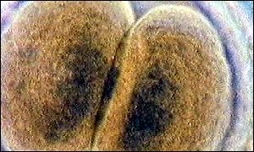
Monday, 28 October, 2002, 20:31 GMT
Embryo mix-up at IVF hospital
Embryos were put back in the wrong women
IVF blunder at a London hospital left two women with the wrong embryos put back into their wombs, it has been revealed.

Slide 54
SCMPMD
Risk Factor Approach
Microbiological and process contamination
Disease transmission
Delivery of un-wanted cells
Undesired modification of cells, e.g. during gene transfection
Mix-ups with autologous derived products
Scaffolds and cell-scaffold interactions
Sterility of final product
Toxicity of process additives
Performance of final product
Patient specific responses

Slide 55
SCMPMD
Recommendations
A New Regulatory Body should have oversight of tissue engineering products
This organisation should define more closely the scope of tissue engineering products
Tissue engineering products and processes should be classified according to their level of risk, based on the risks associated with the performance of the final product. With the highest risk products, there should be regulatory control over First-in-Man
Tissue engineering should be regulated by a process totally different to medical devices
Institutions involved with tissue engineering should be licensed or accredited

Slide 56
Risk Management in the Use of Animal Tissues in Medical Devices
Tit for Tat ; in whose interests
Blood products
West Nile Virus

Slide 57
Human embryonic stem cells have been grown in the UK for the first time, a team at King's College London, August 2003
Stem cell research and therapeutic cloning Royal Society, November 2000
Degenerative diseases and serious injuries to organs and tissues may be treated through stem cell therapies.
Research on human embryonic stem cells will be required to investigate all of the potential therapies because other cell types, such as adult stem cells, may not have the same breadth of applications.
The proposed legislative controls will be sufficient to prevent reproductive cloning (i.e. the cloning of people) while still allowing the development of therapeutic applications of cloning technology.
The Royal Society believes that the proposed new regulations under the 1990 Human Fertilisation and Embryology Act, which would allow research on human embryonic stem cells, are scientifically necessary to realise fully the potential of stem cell therapies.

Slide 58
China Makes Progress in Human Embryonic Stem Cell Research
The Ministry of Health has recently reported success at the Stem Cell Research Center of the Second Hospital attached to Zhongshan University. The work at the center has led to China being one of only a few countries where human embryonic stem cell systems have been produced. The center has also succeeded in inducing mice embryonic stem cells to develop on into hemopoietic stem cells, associated with blood production, by using the “phasing method” for the first time in China. These achievements are considered of significant value to the development of hemopoietic stem cell transplants in clinical practice. Professor Huang Shaoliang, head of the Stem Cell Research Center and researcher He Zhixu have succeeded in establishing three human embryonic stem cell systems styled CHE1, CHE2 and CHE3. They used material taken from the ball of cells known as the blastula that develops out of the original single-cell or human zygote.

Slide 59
The European Union also has a major problem on its hands with ES research. New guidelines proposed by the European Commission last month, aimed at appeasing Catholic countries and stemming a scientific ‘brain drain,' are set to be vehemently opposed by some member states.
The one-year moratorium was introduced in September last year when the European Council of Science Ministers approved Europe's current four-year research program (Sixth Framework). The moratorium was instigated on the understanding that provisions for funding ES research would be established before the end of 2003. These were announced on July 9, and, if ratified, they will form the guidelines under which some forms of ES research will receive EU backing. The problem is that countries that have banned embryo research — notably Germany, Italy, Austria, and Ireland — do not want their communal EU taxes supporting this work in other countries and are likely to oppose the guidelines.

Slide 60
Litigation: facilitator or ruin of innovation?
Proplast / Vitek TMJ No effective lessons
Altered materials- medical device
relationship
Silicone gel breast implants No scientific lessons
Helped alter pharma-medical device
relationship
Bjork-Shiley heart valve Good engineering / manufacturing lessons
Helped alter pharma-medical device
relationship
Pedicle screws Lessons concerning off-label use and
marketing
Experience probably stimulated new
developments in spinal surgery
Sulzer hips Lessons in manufacturing and quality systems
Helped alter engineering-medical device
relationship

Slide 61
Classic product cycle
USA
Idea, patent, prototype
Europe
Clinical Trial, data
USA
Regulatory Approval
profits
Europe
Regulatory Approval
more data

Slide 62
Litigation biased cycle
USA
Idea, patent, prototype
Europe
Clinical Trial, data
USA
Class action,
Disaster
Europe
Adverse events

Slide 63
Medical Technology Innovation: The Role of SCENIHR
The European Commission, September 2004
DG Sanco
The Scientific Committee for Emerging and Newly Identified Health Risks
SCENIHR will advise on emerging or newly-identified health risks and on broad issues requiring a comprehensive assessment of risks to consumer safety or public health, not covered by other EU bodies.
Examples could include antimicrobial resistance, new technologies such as nanotechnologies, medical devices, including substances of human or animal origin, tissue engineering and electromagnetic fields
NOTE; A working group will publish an Opinion on the Health Risks of Nanotechnology in September. Any views may be sent to DFW as chair of the group, dfw@liv.ac.uk

Slide 64
Tissue Engineering Clinical Need, Opportunities and Responsibilities
The importance of unmet clinical need: dentistry vs heart failure
Questions of trauma or degenerative disease in orthopaedics
Measuring outcomes of clinical trials
The optimal time for human clinical trials – will this depend on geography

Slide 65
Tissue Engineering Business Need, Opportunities and Responsibilities
Can autologous tissue engineering ever be commercially successful
Will it be possible to translate from ex vivo bioreactors to in vivo bioreactors to reduce costs and risks
Can allogeneic products work efficiently, safely and commercially – will the volumes be large enough and supply chains robust enough
Who will be able to make profits out of tissue engineering and when
Will the best business models be based on commercially operated tissue facilities within medical institutions, supplied by manufacturers of scaffolds and bioreactors and cell lines.

